Slide 1

Promotion Bump Assignment
Hasan Enes Güray

Slide 2
Introduction
Objective
Measure the effects of promotions on sales performance across different stores and products for a retail company.
Dataset Overview
Two sales datasets: before and after August 1, 2015.
Promotion schedule with six promotions.
Product group classification dataset.
Methodology
Clustering of products and stores into Fast, Medium, and Slow categories using quantile-based separation.
Developed regression models to measure the impact of promotions.

Slide 3
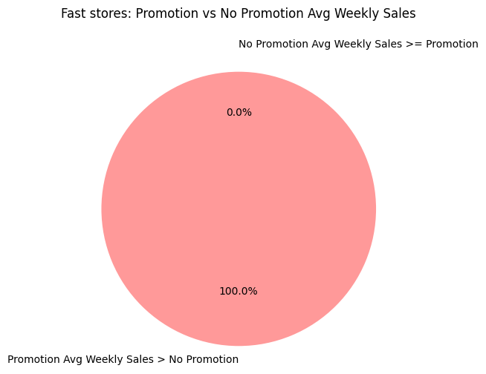
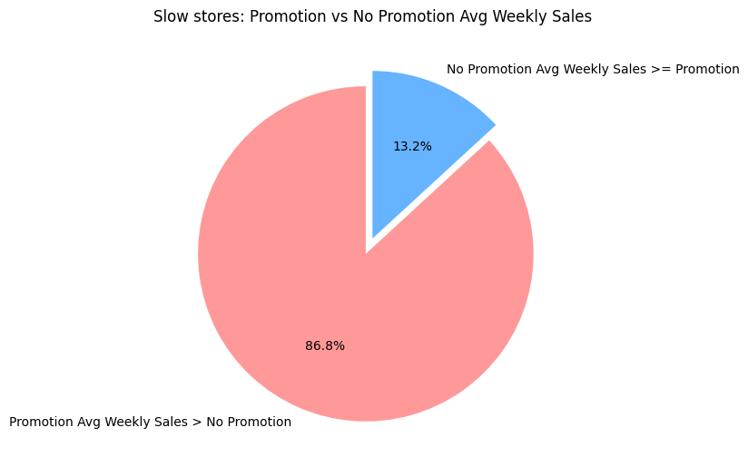
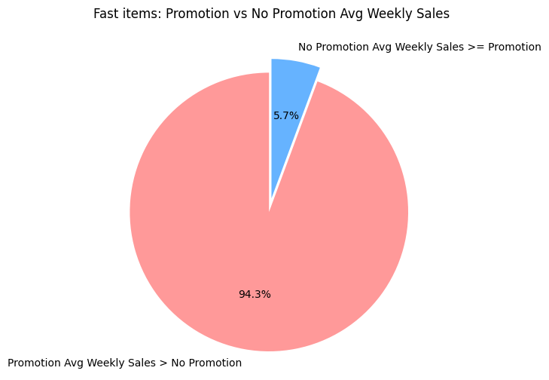
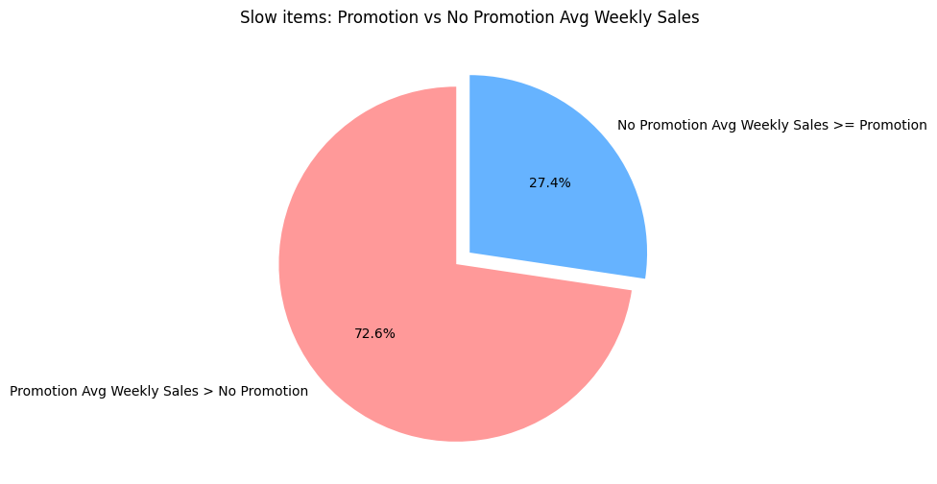
Clustering of Products and Stores
Clustering Approach:
Criteria for clustering: Average weekly sales during non-promotion periods.
Products and stores were classified into Fast, Medium, and Slow categories.
Why Quantile-Based Method?:
Ensures balanced representation across categories for more accurate analysis.

Slide 4
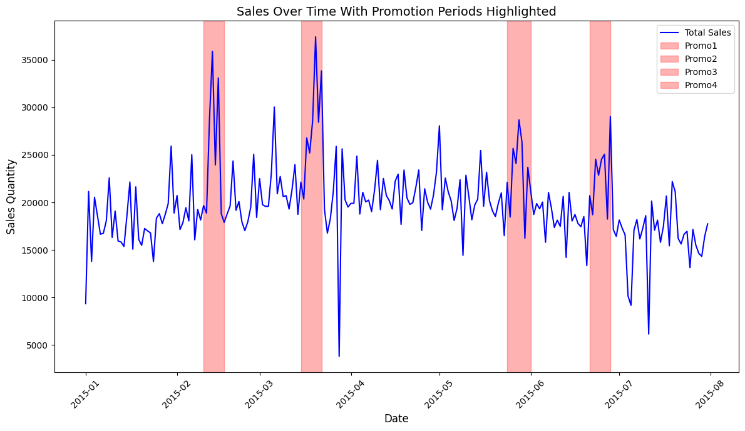


Promotion Impact Analysis
OLS Regression Models:
Focus on the two models (products and stores).
Key variables: promotion periods, product codes, and store codes.
Findings:
Product Model: R² = 0.81, significant promotion impact.
Store Model: R² = 0.60, promotion impact weaker compared to products.

Slide 5
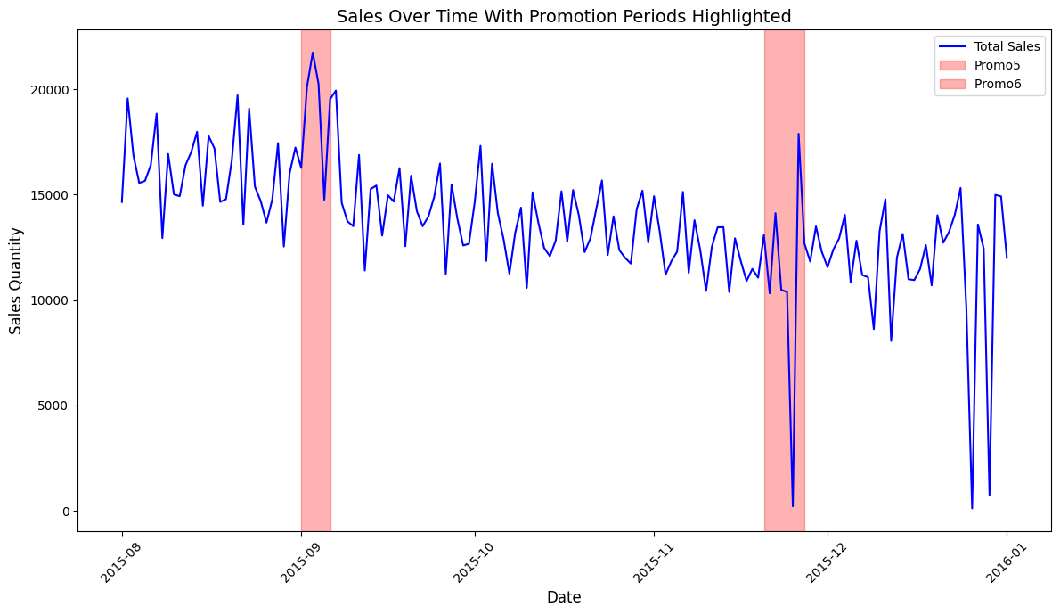
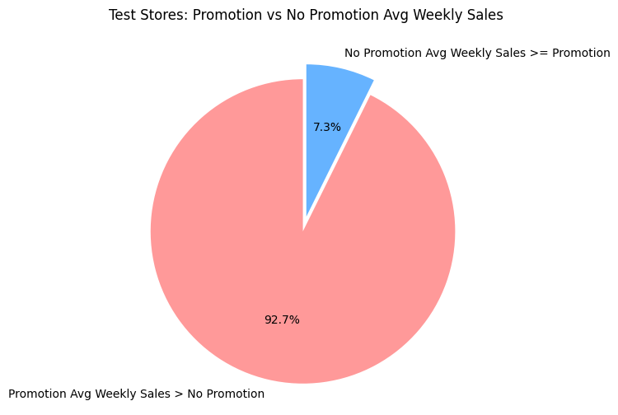
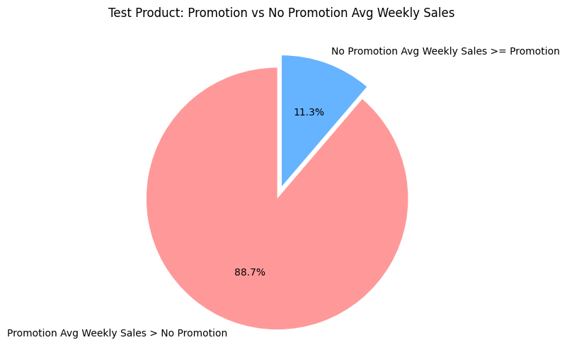
Forecasting & Model Evaluation
Evaluated the model’s performance on the second dataset.
Moderate fit with product-level model (R² = 0.46) but weaker fit for store-level model (R² = 0.21).

Slide 6
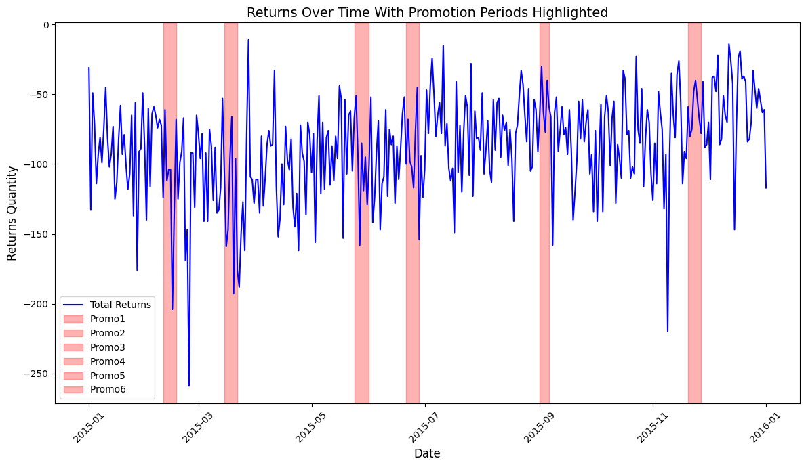
Return Analysis
Returns increase during and after promotions, suggesting that promotional sales might lead to higher return rates.
The analysis shows significant fluctuations in return rates, with spikes during promotion periods.

Slide 7
Key Insights & Recommendations
Insights:
Promotions are more effective for Fast items and Fast stores.
Slow items and stores show more varied responses.
Return rates tend to increase post-promotion.
Recommendations:
Tailored promotion strategies for Fast vs. Slow products.
Store-specific promotion optimizations.
Consider stricter return policies or better product descriptions during promotional periods.
Conclusion:
Promotions drive short-term sales increases, but strategies must be refined for long-term success.

Slide 8

Thank you!

